Slide 1
Stock Price Analysis of Quarterly Data
Gavin McIntosh
and
Erykah Gieb

Slide 2
Chosen Data Sets
We found our data on Kaggle
The data set is titled, “S&P 500 stocks price with financial statement”.
This data set includes information for statistics, values, balance sheets, and flow.

Slide 3


GitHub
In order to efficiently work together, we used a free application called GitHub. GitHub allowed us to each work on our own task and share files online.
The feature we used the most was simply committing or pulling files to and from our repository.

Slide 4


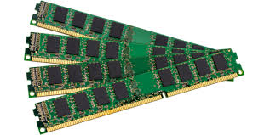
One of the biggest problems we encountered was R Studio eating all of our available ram.
Another issue was getting R to run the data, which led to having to clean the data to decrease its size. R did not like having a data set that was too big.

Slide 5

Cleaning the Data
After working with the data for a bit, we decided to clean it up
This consisted of removing unnecessary data and renaming certain columns to work with our code.

Slide 6
Results
The following slides details the results from differing methods, including, but not limited to, decision trees, Bayes, and neural networks.

Slide 7
Decision Trees

Slide 8
Knn

Slide 9
Bayes Theorem

Slide 10
ROC Curve

Slide 11
SVM

Slide 12
Logistic Function

Slide 13
Neural Network-NN

Slide 14
Gradient Boosting

Slide 15
Bagging

Slide 16

Conclusion

Slide 17
Thank You!

